Slide 1

Academic Analytics: Predictions around Argentine “Aprender” National Evaluation
EPPS 6323 Knowledge Mining
Dr. Karl Ho
Student: Federico Ferrero

Slide 2
Objective
To conduct both an Exploratory Data Analysis and a Predictive Analysis that uses Machine Learning techniques with the purpose of finding the most accurate and adequate predictive hypotheses for the Argentine “Aprender” National Evaluation.

Slide 3
National Evaluation Operation “Aprender”
Argentine Ministry of Education, Culture, Science and Technology.
Annual administration.
Population: all high-school seniors in Argentina.
Evaluation purpose: “to generate timely and quality information to better understand the achievements and pending challenges around students' learning” (Aprender, 2019).
Traditionally, predominant use of descriptive techniques.
Collects data on knowledge of Mathematics, Language, and contextual information of the respondent students.

Slide 4
Data
2019 edition.
N=34,191 high-school seniors (Cordoba Province).
Dependent Variables (2):
Language Performance (ldesemp) and Math Performance (mdesemp):
4 categories: below basic level, basic, satisfactory, and advanced.
Independent Variables (246):
gender, sector (public or private), ambit (rural or urban), student socio-economic situation, student cultural consumption, school climate, student self-perception, educational practices and use of technology, migration status, etcetera.

Slide 5
Analysis strategies
Exploratory Data Analysis using visualizations:
Traditional variables: Sector, Ambit, Gender, Repetition, Student Employment, Student Socioeconomic Level.
Finding the Best Model using regsubsets with leaps package:
Math Performance: Forward selection.
Language Performance: Backward selection.
Supervised Learning techniques:
Simple regression.
Tree-Based-methods.

Slide 6
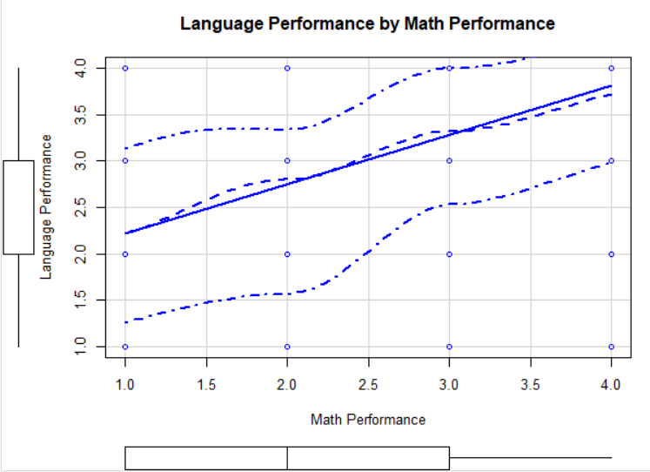
Exploratory Data Analysis
Positive and linear association between Language Performance and Math Performance.

Slide 7
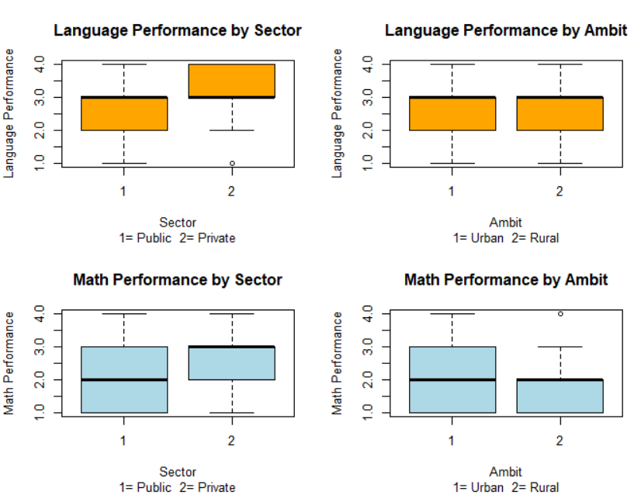
Students’ performances by Sector and Ambit
Sector:
1= Public
2= Private
Ambit:
1= Urban
2= Rural
Language Scores: better performance at private schools and no differences between ambits. 50% of cases in private schools are between satisfactory and advanced. In the public system, 50% between basic and satisfactory.
Math Scores: better performance in private and urban schools. 50 % of cases in private schools are between satisfactory and advanced. In public system, 50% between below basic and satisfactory. Performance in rural is worse than in urban schools.

Slide 8
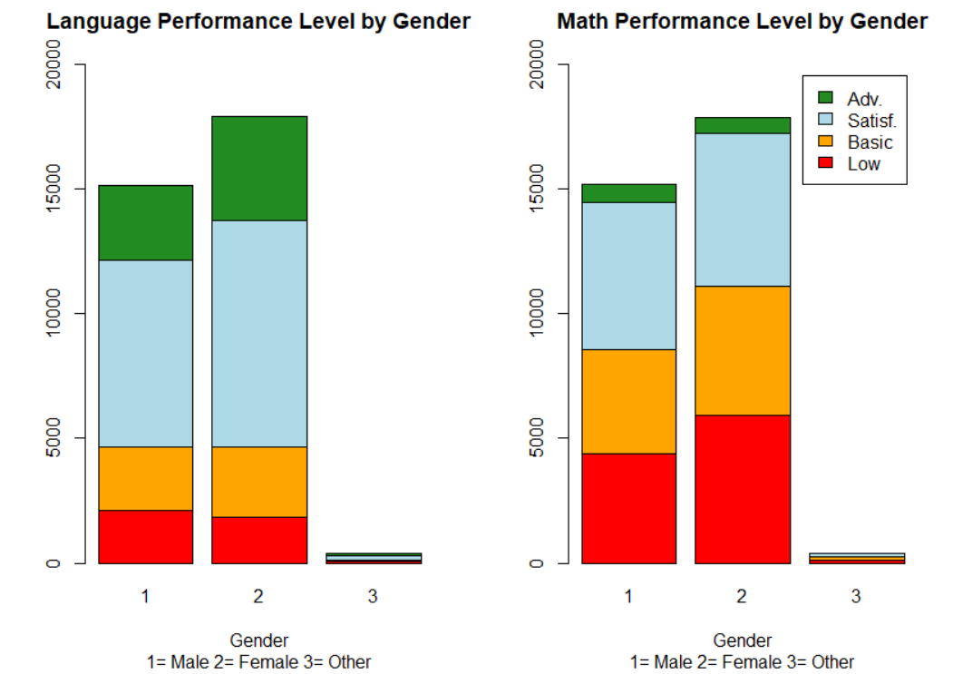
Students’ performances by Gender
Language Scores: better performance in women (39% at least obtain the satisfactory level while 31% of men achieve this level). Both groups have 13% of students in basic and low level.
Math Scores: worse performance in women (32% obtain low and basic levels against 25% in the case of male students). Both groups have 19% of students in satisfactory and advanced levels.

Slide 9
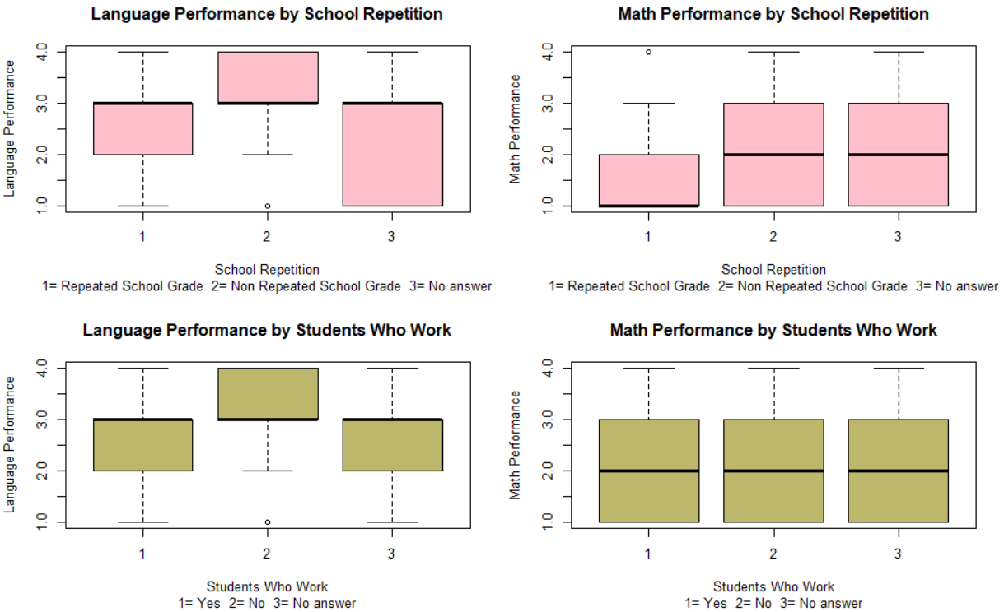
Students’ performances by Repetition and Work Experience
Language Scores: clear better performance in non-repitent students and students who don’t work.
Math Scores: better performance in non-repitent students. No apparent differences when considered worker students. A considerable number of missing values.

Slide 10
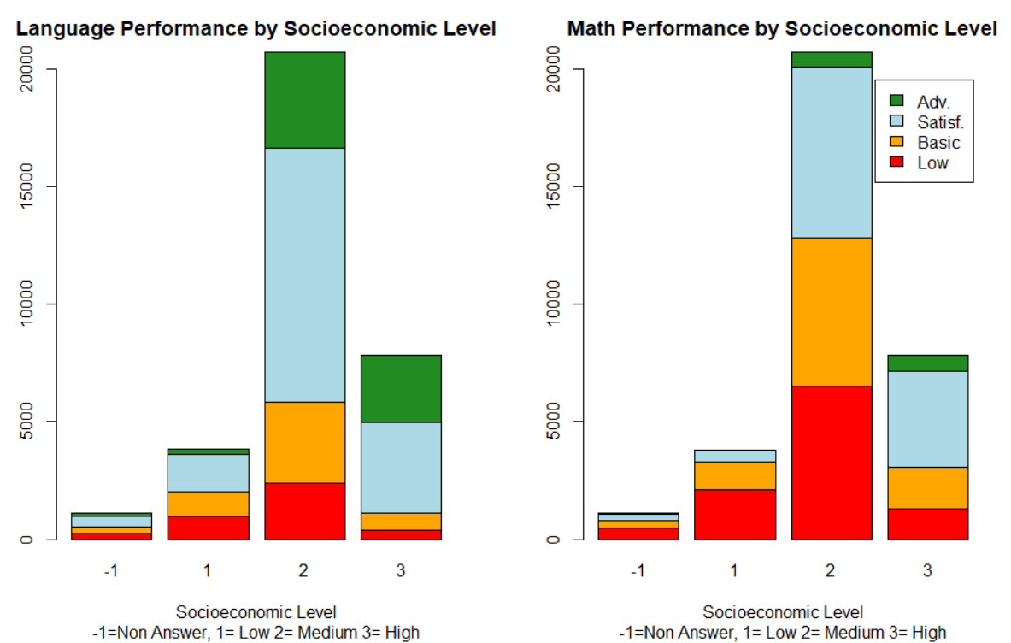
Students’ Performances by Socioeconomic Level
Language Scores: predominantly middle socioeconomic level students who obtain at least a satisfactory level (44%).
Math Scores: predominantly middle socioeconomic level students who obtain low and basic level (37%).

Slide 11
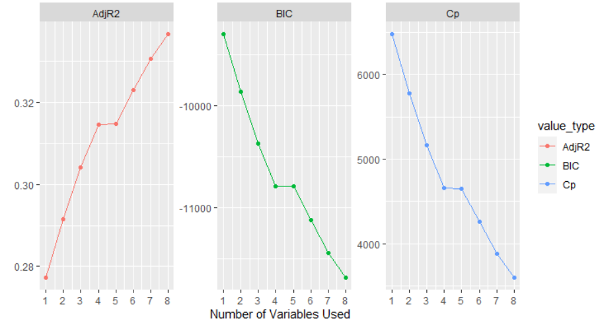
How Many IV are the Optimal Number When Predicting Language Performance?
5 seems to be the better number of predictors for the model when predicting Language Performance: high AdjR2 and low BIC and Cp.

Slide 12
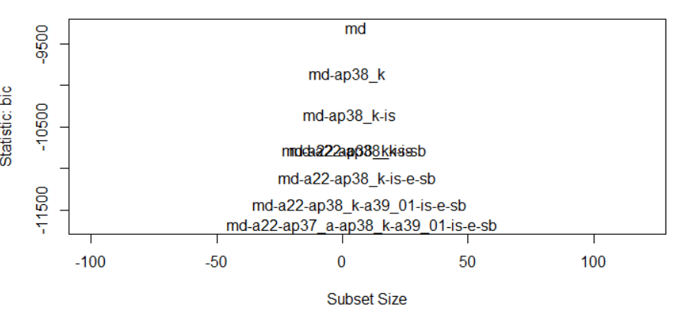
What are the Best Predictors of Language Performance?
1) Math Performance (md)
3) How difficult are the following activities for you? Understanding a text (a39_01)
2) Do you receive payment for the job? (a22)
4) Student's socio-economical index (is)
3) Sex Education Variable (ap38_k)
5) Extra-age (sb)

Slide 13
5 Best Predictors of Language Performance
Math Performance (mdesemp)
Do you receive payment for the job you do outside your home? (ap22)
How difficult are the following activities for you? Understanding a text (a39_01)
Student's socio-economical index (isocioa)
Extra-age (sobreedad)

Slide 14
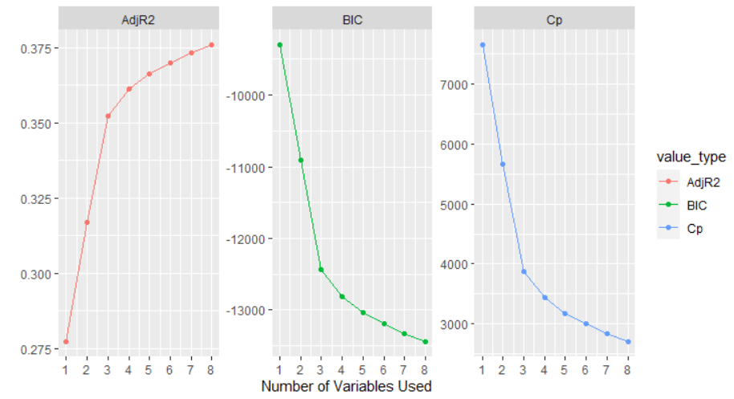
How Many IV are the Optimal Number When Predicting Math Performance?
8 seems to be the better number of predictors for the model when predicting Math Performance: high AdjR2 and low BIC and Cp.

Slide 15
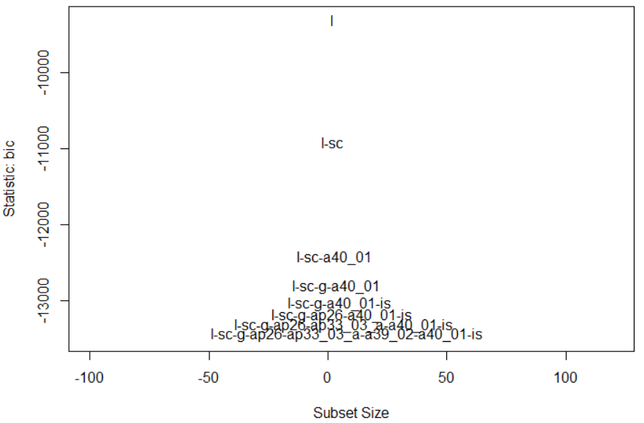
What are the Best Predictors of Math Performance?
1) Language Performance (l)
5) School service (ap33_03_a)
5) How difficult do you find? Writing a text (a39_02_a)
2) Sector (sc)
3) Gender (g)
6) Agree with: “I enjoy studying Mathematics” (a40_01)
4) Absenteeism (ap26)
7) Student's socio-economical index (is)

Slide 16
7 Best Predictors of Math Performance
Language Performance (ldesemp)
Sector (either public or private) (sector)
Gender (gender)
Absenteeism. So far this year, how many times have you missed school? (ap26)
How difficult do you find the following activities? Writing a text (ap39_02)
To what extent do you agree with the following statements? I enjoy studying Mathematics (ap40_01)
Student's socio-economical index (isocia)

Slide 17
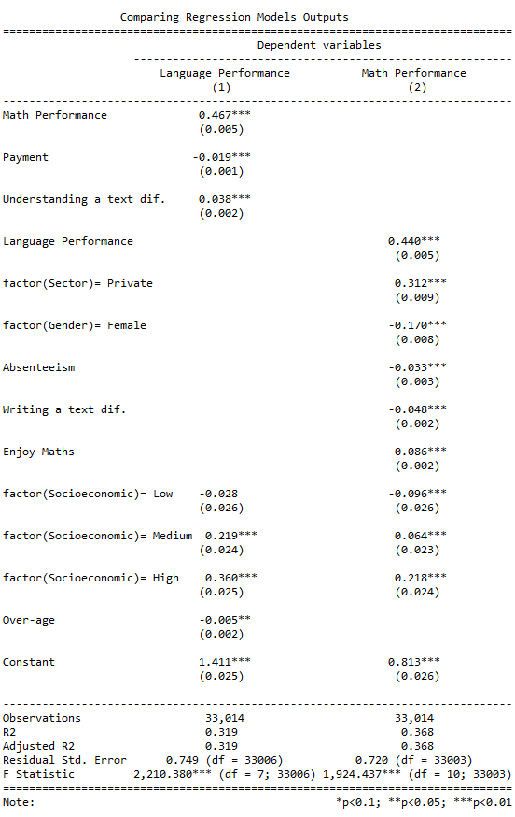
Linear Regressions Outputs
Language Performance:
Positive association:
Math performance, Difficulty in understanding a text, Student’ medium and high socioeconomic level (p<0.01).
Negative association:
Payment for a job (p<0.01), Student’s low socioeconomic level (p<0.01), over-age (p<0.05).
Math Performance:
Positive association:
Language performance, Private sector, Enjoying Maths, Student’ medium and high socioeconomic level (p<0.01).
Negative association:
Absenteeism, Female, Difficulty in writing a text, Student’s low socioeconomic level (p<0.01).

Slide 18
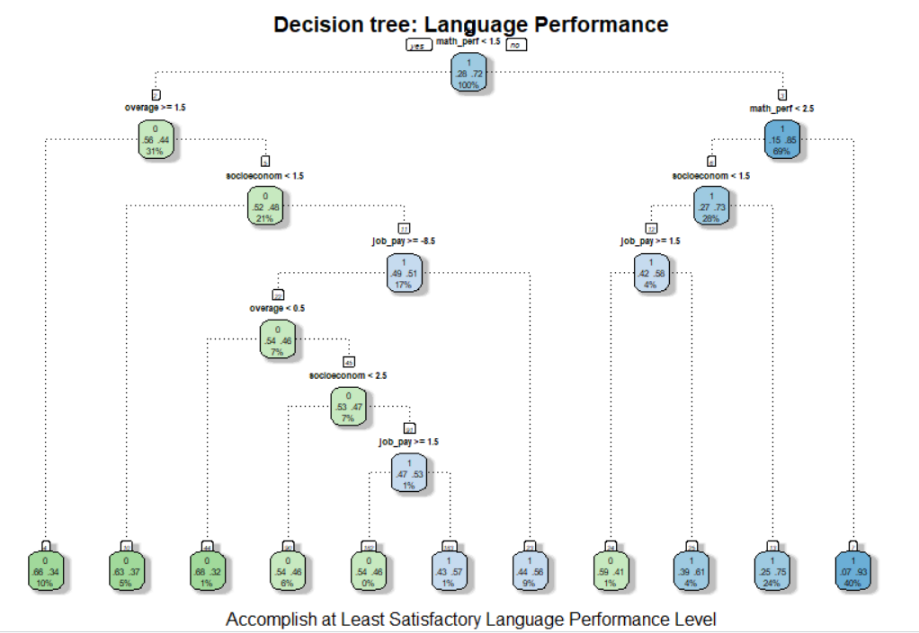

Tree-Based Methods: Language Performance
Let’s try a case: a student who has…
Math Performance higher than 1.5 but less than 2.5 (basic level)
Socioeconomic level lower than 1.5 (low index)
And a job payment value higher or equal to 1.5 (which means that the student doesn't work)
Has 4% of chances of accomplishing at least satisfactory Language Performance Level.

Slide 19
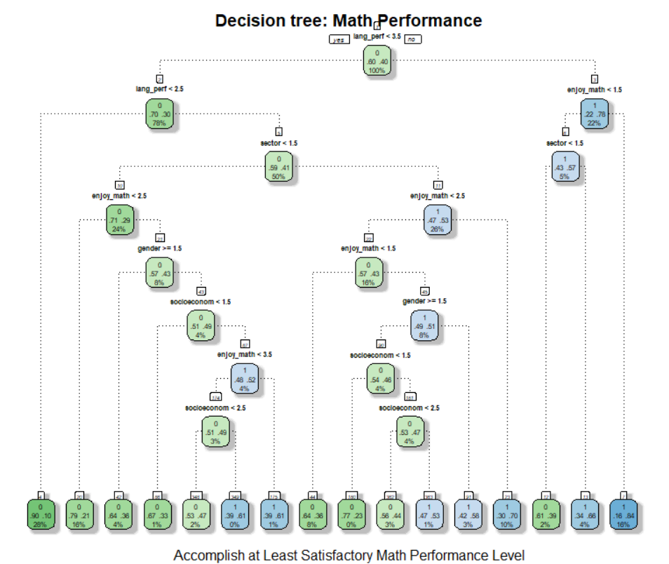

Tree-Based Methods: Math Performance
Let’s try another case: a student who…
Language Performance lower than 3.5 but higher than 2.5 (satisfactory level)
Attends to a public school (Sector value lower than 1.5)
And the enjoy math value is lower than 2.5 (which means that does not agree with the sentence)
Has 10% of chances of accomplishing at least satisfactory Math Performance Level.

Slide 20
Tree-Based Methods: Which predictive method is more accurate?
 |  | Language Performance | Math Performance
Decision Tree | Accuracy | 0.7679725 | 0.7649435
 | Predicted Accomplish rate | 0.8090665 | 0.7415507
Conditional Inference Tree | Accuracy | 0.7653473 | 0.7610057
 | Predicted Accomplish rate | 0.7986811 | 0.7513612

Slide 21
Code and Outputs
https://federico-jf.github.io/Knowledge-Mining/Final-Project.html

Slide 22
Final ideas
Most accurate predictive hypotheses for the Argentine “Aprender” National Evaluation can be identified using Machine Learning techniques.
Traditional/classic pedagogical variables are not always the ones that best predict performance according to the Machine Learning techniques used here.
An analysis of this type can help to adequately identify the dimensions to promote in projects for the design of educational public policies.
The prediction used to identify students at risk and then to make interventions aimed at strengthening desired performances can be an interesting pedagogical strategy.

Slide 23
References
Acharya, M. S., Armaan, A., & Antony, A. S. (2019, February). A comparison of regression models for prediction of graduate admissions. In 2019 International Conference on Computational Intelligence in Data Science (ICCIDS) (pp. 1-5). IEEE.
Siegel, E. (2016). Predictive Analytics. The power to predict who will click, buy, lie or die. New Jersey: John Wiley and Sons.
Holmes, W., Bialik, M. and Fadel, C. (2019) Artificial intelligence in education: promises and implications for teaching and learning. Boston, MA: The Center for Curriculum Redesign.
Jayaprakash, S. M., Moody, E. W., Lauría, E. J., Regan, J. R., & Baron, J. D. (2014). Early alert of academically at-risk students: An open source analytics initiative. Journal of Learning Analytics, 1(1), 6-47.
Williamson, B. (2016). Digital education governance: data visualization, predictive analytics, and ‘real-time’policy instruments. Journal of Education Policy, 31(2), 123-141.

Slide 24
Thank you!

